Slide 1
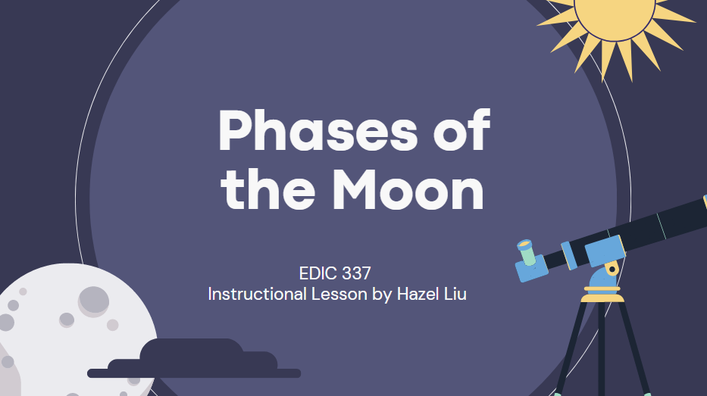

Slide 3
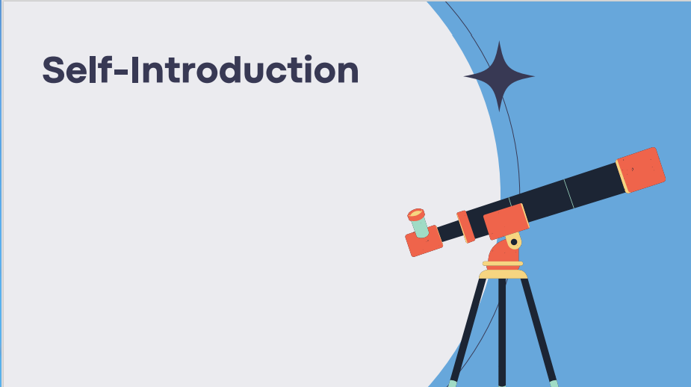
My name is Hazel Liu. I am glad to explore the world of the moon and stars with you!
This is my second year studying in Uvic, majoring in economics.
I am also very interested in the changes of the moon and stars. Therefore, I create this mini course and would like to share with you the phases of the moon and mysterious constellations.

Slide 4
This is a beginner course of moon and stars.
The topic is about teaching the words related to the moon in unit 1; the definition and characteristics of phases of the moon in unit 2.
The goal is to allow students have a better understanding of how the moon moves and gain a new perspective on star patterns.

Slide 5
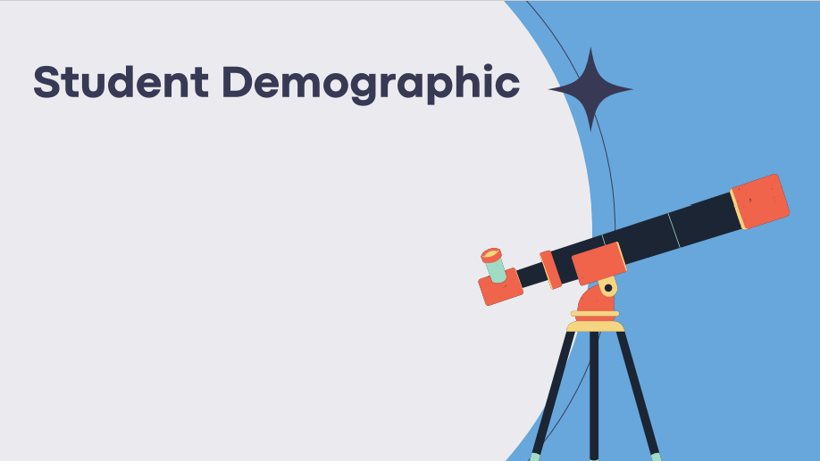
This course is intended for students who are interested in space and the changes of the moon.
The minimum age for this course would be recommended to Grade 4 students. Also, this course is also created for students who are English language learners.
I would mainly use scaffolding steps and student-centered discussions, multimedia strategies to help learn individually.

Slide 6
There are a variety of multimedia methods and materials used in this course.
Customized Video Lesson
Google Form Short Essay Questions
YouTube Video
Online Discussion Form
Google Form Quiz

Slide 7
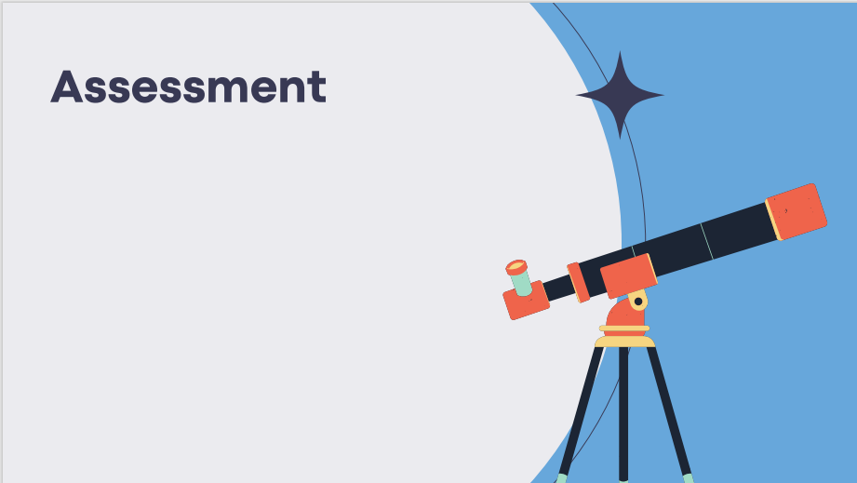
Unit 1: Words about the Moon
Pre-assessment: 10%
Online Discussion Forum: 20%
Unit 2: Phases of the Moon
Quiz: 10%
Online Discussion Forum: 20%
Final Project
Observation Diary: 40%

Slide 8
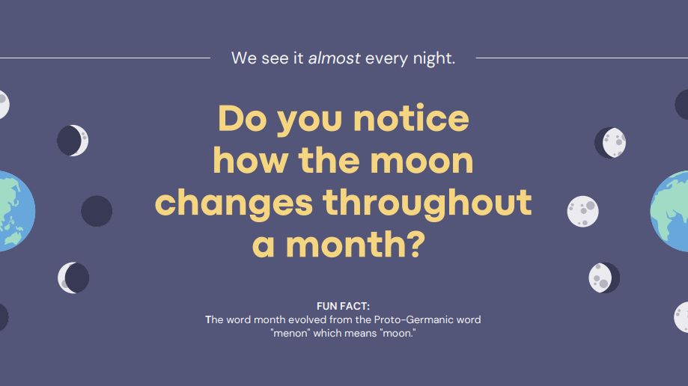

Slide 10
Remember
Describe. What is the meaning of the moon? Describe the moon’s color changes; shape appears to change during the month and some popular cultural stories.
Understand
Define. How would you define the vocabularies in your own words? Explain what you think these words mean?

Slide 11
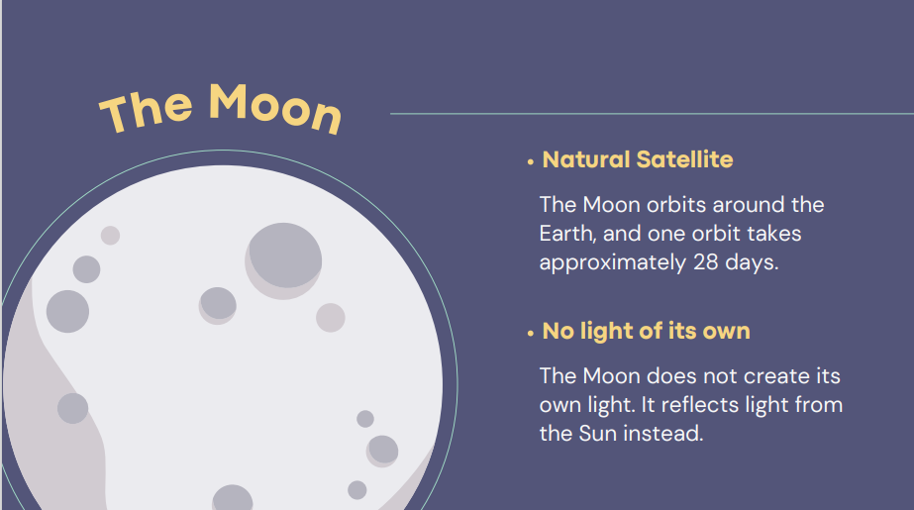

Slide 12
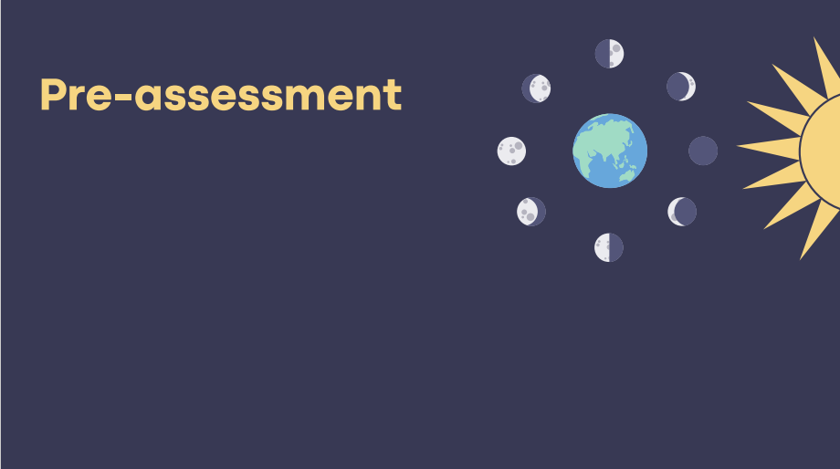
Students will take this pre-assessment about anything related to the moon. This counts to 10% to your grade.
The purpose of doing this assessment is to inspire students with a brainstorming bubble for the word “Moon”.
Click here to start! https://docs.google.com/forms/d/1ItTStOrI94I1Hkwo-MfSipB53VJUlH0ehHw_a_0VENg/edit

Slide 13
Watch this video for more information
https://www.youtube.com/watch?v=RJ2bQWH6GCM

Slide 14
In this discussion thread, you are going to write about the definition of the new words in your own words. After learning this course, you will have a basic understanding of the words. You need to write down your own definition with related images beside the words.
Example:
moon: the natural satellite of earth; (picture)
star, an enormous ball of plasma.(picture)
Remember to post a reply to at least one classmate in no more than 100 words.

Slide 16
Remember: Describe different kinds of phases of the moon. What are the characteristics?
Understand: Define. How would you define the main characteristics of moon in four stages?
Apply: Classify. What examples can you find? Perform the scene.
Analyze: Outline. What are the features of the phases of the moon? Try to compare the differences.
Evaluate: Decide. What would you recommend for the contents in the discussion forum?
Create :Design. Design a creative narration with the phases of the moon.

Slide 17
Watch this video for more information
https://www.youtube.com/watch?v=BQvo7vyCmuE

Slide 18
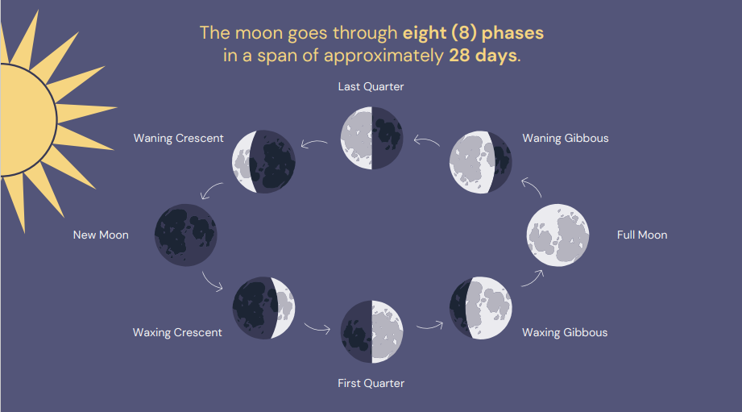

Slide 19
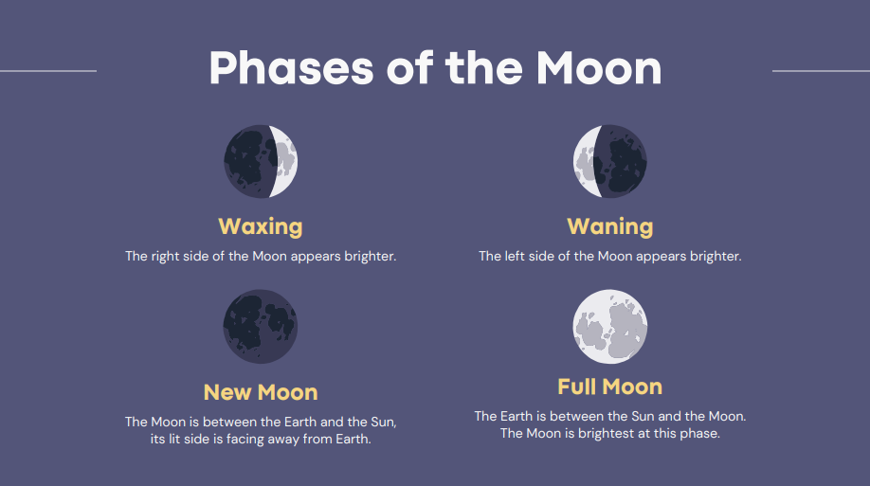

Slide 20
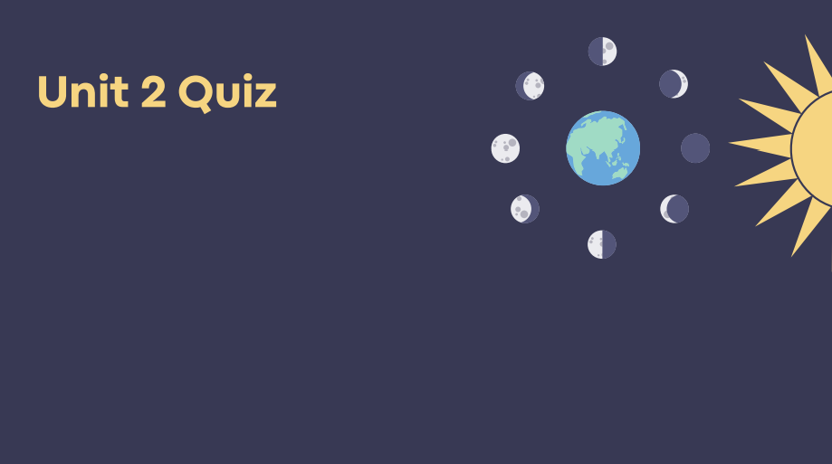
You are going to have 5 multiple choice questions related to the definition, shapes, or changes of the phases of the moon.
Click here to start!
https://docs.google.com/forms/d/19_I6uK199IfqEy-NTT0QEDIrBSUqLDdTENLoCvrOBTQ/edit

Slide 21
In this discussion thread, you are going to write a narration to mention every phase and express your understanding among these phases.
For example: Luna the crescent moon was feeling sad that she was not as full or complete as her neighbor, “Full moon.”
After sharing their stories about four phases of the moon, you are going to reply at least one classmate in no more than 100 words.

Slide 22
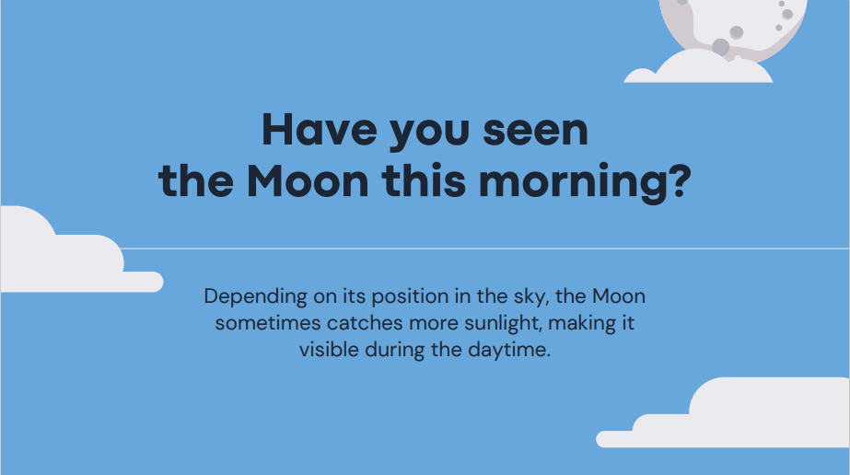

Slide 25
In the final project, you are going to write an observation diary about the phases of the moon or write a science fiction related to the moon.
#1
Based on what you have learned in this course, describes the phases of the moon. Then look at the night sky every 2-3 days and note what the Moon looks like. How long does it take before the Moon moves from one phase to another?
You can add pictures besides the texts to serve as the evidence to prove your observation.
The form of the observation diary can be any forms as you like. Minimum 400 words.
#2
Based on the instructional video about science fiction, you can create an interesting science fiction related to the moon.
The form of the science fiction can be any forms as you like. Minimum 400 words.
This project will be due on May 1st 2023!

Slide 27
Science fiction Instructional Video:
https://drive.google.com/drive/my-drive

Slide 29
